Slide 1


Fast and Scalable Hierarchical Linear Solvers
Léopold Cambier
Advisor: Eric Darve
PhD Defense, November 9, 2020
Committee: Juan J. Alonso, Erik G. Boman, Lexing Ying, Michael Saunders (Chair)

Slide 2
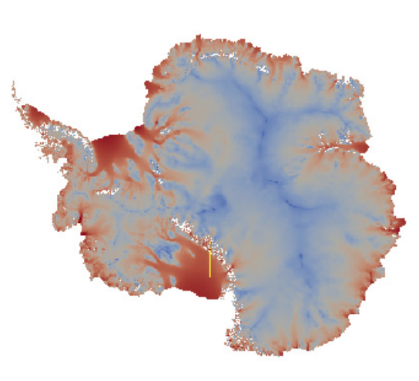
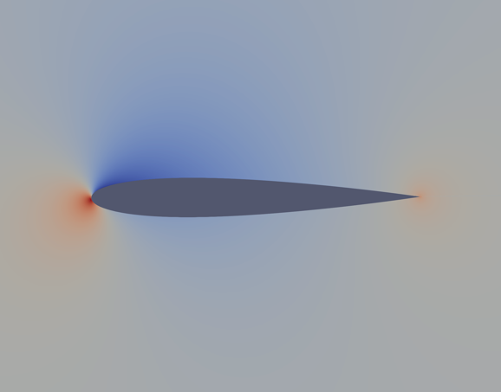
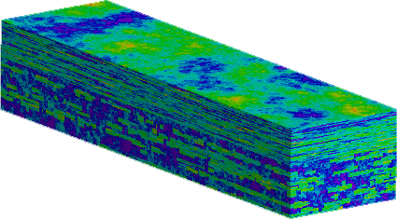
Scientific computing
Natural phenomenon
⇒ Modeling
⇒ Discretization
⇒ Computer simulation

Slide 3


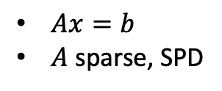
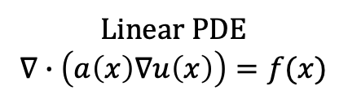
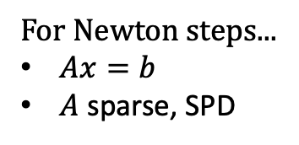

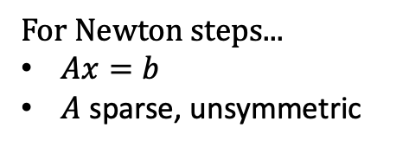
Scientific computing needs linear solvers
For Newton steps...
$Ax=b$
$A$ sparse, unsymmetric
PDE $F(x)=0$
Linear PDE
$$∇∙\left(a\left(x\right)∇u\left(x\right)\right)=f(x)$$
PDE $F(x)=0$
$Ax=b$
$A$ sparse, SPD
For Newton steps...
$Ax=b$
$A$ sparse, SPD

Slide 4

Scientific computing needs parallel computing
Even fast algorithms cannot solve problems with 100M+ unknowns...

Slide 5
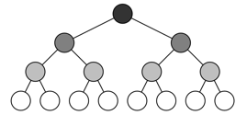
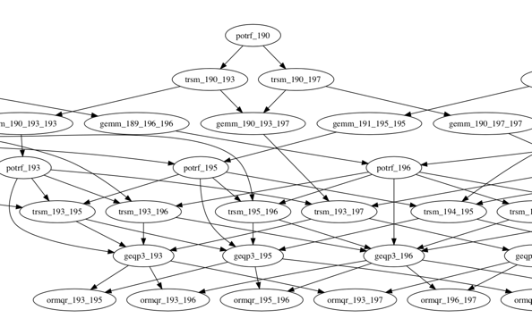

Three-parts talk
Task-based runtimes
TaskTorrent
Sparsified Nested Dissection
(spaND)
$$Ax=b$$
Parallel spaND
with TaskTorrent

Slide 6
Sparsified Nested Dissection
Cambier, L., Chen, C., Boman, E. G., Rajamanickam, S., Tuminaro, R. S., & Darve, E. (2020). An algebraic sparsified nested dissection algorithm using low-rank approximations. SIAM Journal on Matrix Analysis and Applications, 41(2), 715-746.

Slide 7


Why do we want hierarchical solvers?
High accuracy preconditioners
spaND / ...
+ iterative method
Low accuracy preconditioners
ILU(k) / (A)MG / ...
+ iterative method
Direct methods
(Sparse) LU + ordering (ND)
Very accurate
Completely generic
Very costly
Tunable accuracy
Tunable cost
Fairly generic
Cheap
Many iterations
Sometimes more specific
$$A=LU$$
$$A≈∏F_{i}$$
Very slow
Much faster

Slide 8
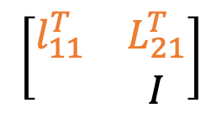
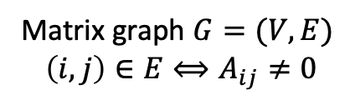
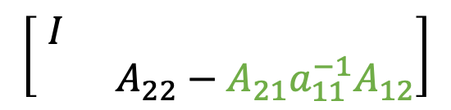

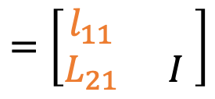
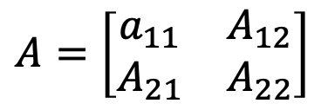
Let’s start from direct methods
$$A=\left[\begin{matrix}a_{11} & A_{12} \\ A_{21} & A_{22}\end{matrix}\right]$$
$$=\left[\begin{matrix}l_{11} & \\ L_{21} & I\end{matrix}\right]$$
$$\left[\begin{matrix}I & \\ & A_{22}−A_{21}a_{11}^{−1}A_{12}\end{matrix}\right]$$
$$\left[\begin{matrix}l_{11}^{T} & L_{21}^{T} \\ & I\end{matrix}\right]$$
1
 | 2
 |  | 3
 |  |  | 4
 |  |  |  | 5
 |  |  |  |  | 6
 |  |  |  |  |  | 7
1
 | 2
 |  | 3
 |  |  | 4
 |  |  |  | 5
 |  |  |  |  | 6
 |  |  |  |  |  | 7
1
 | 2
 |  | 3
 |  |  | 4
 |  |  |  | 5
 |  |  |  |  | 6
 |  |  |  |  |  | 7
1
1
1
6
6
6
5
5
4
5
4
4
2
2
2
7
7
3
7
3
3
Matrix graph $G=(V,E)$
$\left(i,j\right)∈E⟺A_{ij}≠0$
$A$, symmetric, SPD

Slide 9
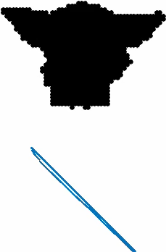
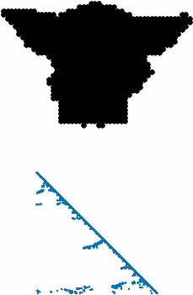



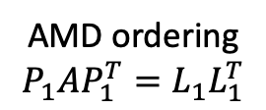
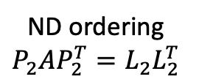


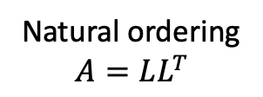

Not all orderings are equal
$A$ (4k nnz)
Natural ordering
$$A=LL^{T}$$
AMD ordering
$$P_{1}AP_{1}^{T}=L_{1}L_{1}^{T}$$
ND ordering
$$P_{2}AP_{2}^{T}=L_{2}L_{2}^{T}$$
$A↦L$ (26k nnz)
${P_{1}AP_{1}^{T}↦L}_{1}$ (8k nnz)
${P_{2}AP_{2}^{T}↦L}_{2}$ (9k nnz)
graph of A

Slide 10

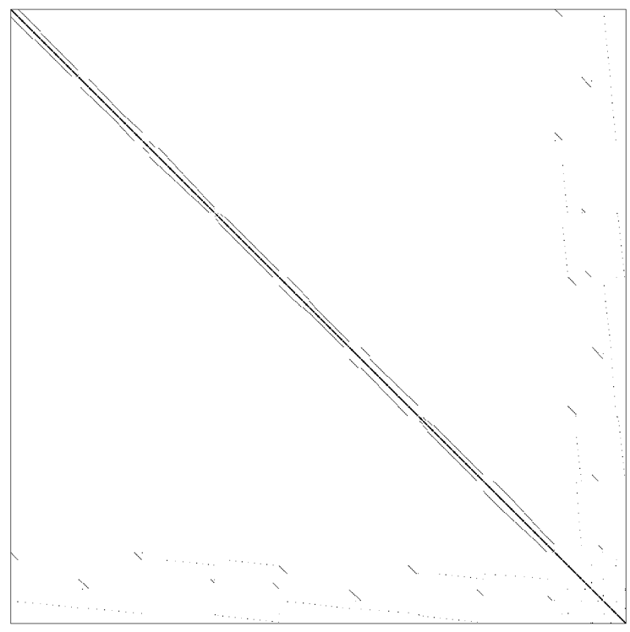
How to minimize fill-in & cost? Nested Dissection!
Eliminate
Top-separator
Leaves

Slide 11
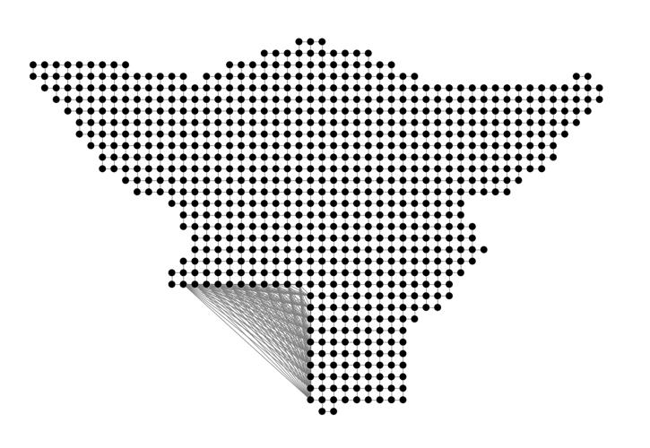
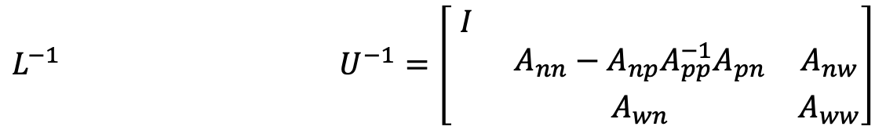


Block elimination
Graph of A
Fill-ins
$$\left[\begin{matrix}A_{pp} & A_{pn} & \\ A_{np} & A_{nn} & A_{nw} \\ & A_{wn} & A_{ww}\end{matrix}\right]$$
$$L^{−1} U^{−1}=\left[\begin{matrix}I & & \\ & A_{nn}−A_{np}A_{pp}^{−1}A_{pn} & A_{nw} \\ & A_{wn} & A_{ww}\end{matrix}\right]$$
$$p$$

Slide 12
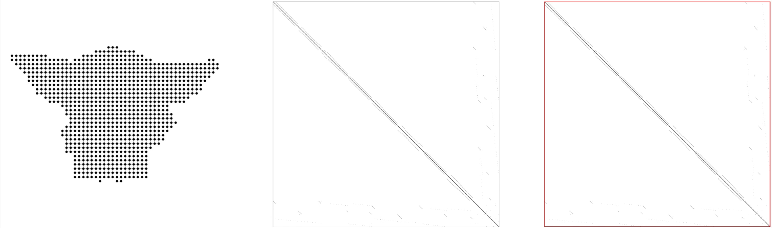
Fill-in in Nested Dissection
Graph of A
Zoom on trailing matrix
Trailing matrix

Slide 13



Direct methods have a lot of fill-ins
Dense block! Cholesky costs $O(m^{3})$
The largest separator, size $m$

Slide 14
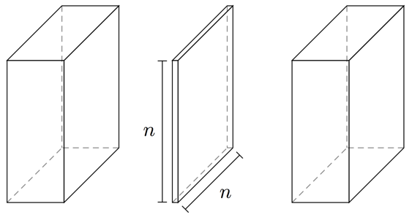


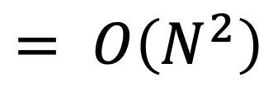



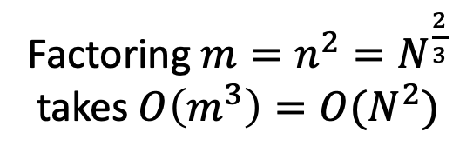

Dense blocks take too long to factor
$$O\left(N^{2}\right)$$
Time
Factoring ${m=n}^{2}=N^{\frac{2}{3}}$
takes $O\left(m^{3}\right)=O(N^{2})$
$$= O\left(N^{2}\right)$$
$$O\left(N\right)$$
$$O\left(n^{2}\right)=O\left(N^{2/3}\right)$$
Leaves
Top separator
$$O(n)$$
$$O(n)$$

Slide 15
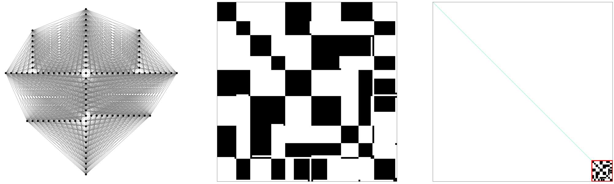






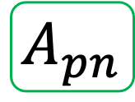
Fill-in is dense but low-rank
Graph of A
Zoom on trailing matrix
Trailing matrix
$$n_{3}$$
$$n_{1}$$
$$A_{np}$$
$$p$$
$$n_{4}$$
$$n_{2}$$
$$A_{pn}$$

Slide 16
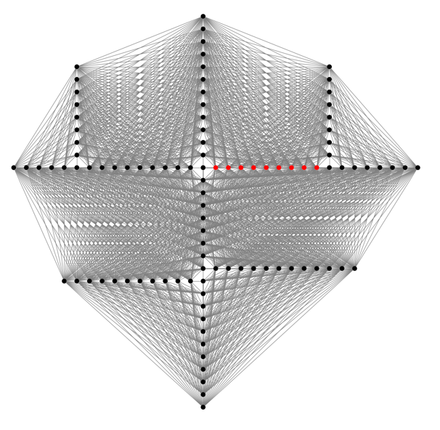

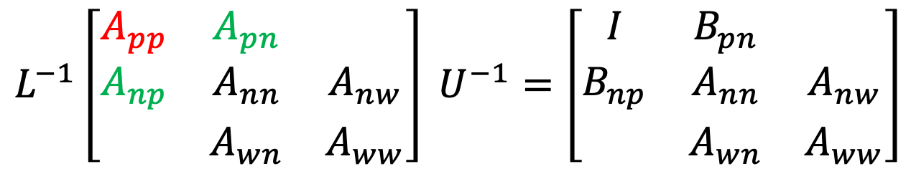




Sparsification: block scaling
$$n_{3}$$
$$n_{1}$$
Not strictly needed
Very important for accuracy
$$p$$
$$n_{4}$$
$$L^{−1}\left[\begin{matrix}A_{pp} & A_{pn} & \\ A_{np} & A_{nn} & A_{nw} \\ & A_{wn} & A_{ww}\end{matrix}\right] U^{−1}=\left[\begin{matrix}I & B_{pn} & \\ B_{np} & A_{nn} & A_{nw} \\ & A_{wn} & A_{ww}\end{matrix}\right]$$
$$n_{2}$$

Slide 17
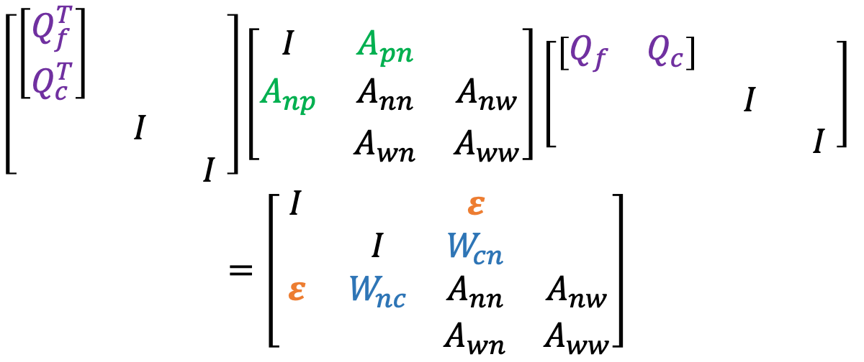
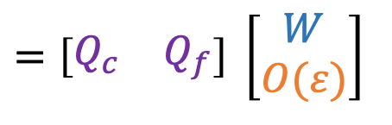
Sparsification: low-rank approximation
$$\left[\begin{matrix}A_{pn} & A_{np}^{T}\end{matrix}\right]=\left[\begin{matrix}A_{pn_{1}} & A_{pn_{2}} & … & A_{n_{1}p}^{T} & A_{n_{2}p}^{T} & …\end{matrix}\right]$$
$$n_{3}$$
$$=\left[\begin{matrix}Q_{c} & Q_{f}\end{matrix}\right] \left[\begin{matrix}W \\ O(ε)\end{matrix}\right]$$
$$n_{1}$$
(RRQR, SVD, ...)
$$p$$
$$n_{4}$$
$$\left[\begin{matrix}\left[\begin{matrix}Q_{f}^{T} \\ Q_{c}^{T}\end{matrix}\right] & & \\ & I & \\ & & I\end{matrix}\right]\left[\begin{matrix}I & A_{pn} & \\ A_{np} & A_{nn} & A_{nw} \\ & A_{wn} & A_{ww}\end{matrix}\right]\left[\begin{matrix}\left[\begin{matrix}Q_{f} & Q_{c}\end{matrix}\right] & & \\ & I & \\ & & I\end{matrix}\right]$$
$$=\left[\begin{matrix}I & & ε & \\ & I & W_{cn} & \\ ε & W_{nc} & A_{nn} & A_{nw} \\ & & A_{wn} & A_{ww}\end{matrix}\right]$$
$$n_{2}$$

Slide 18
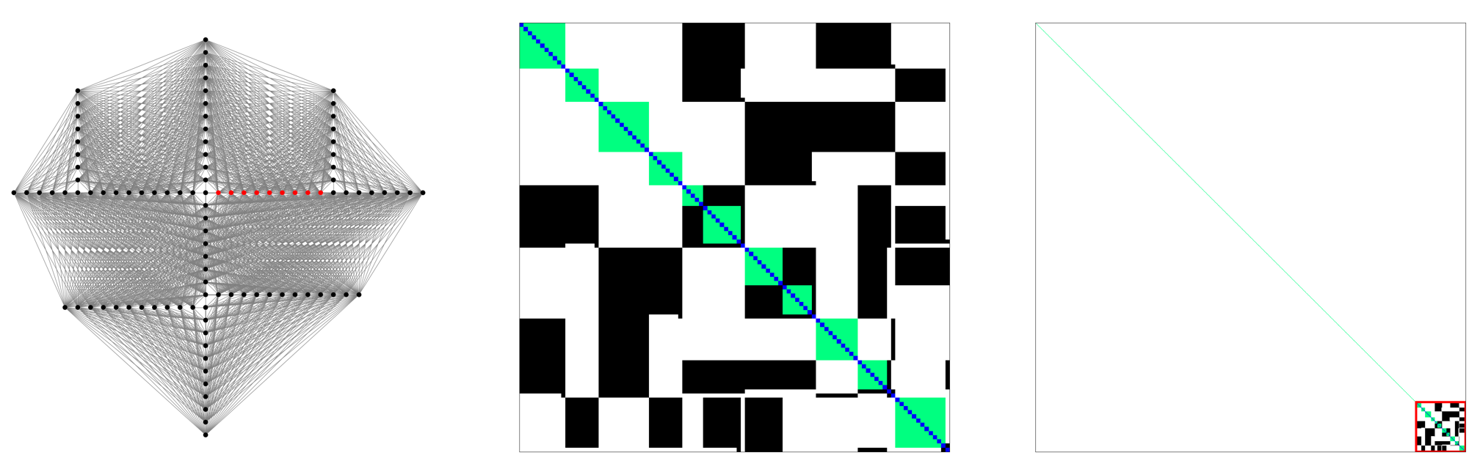
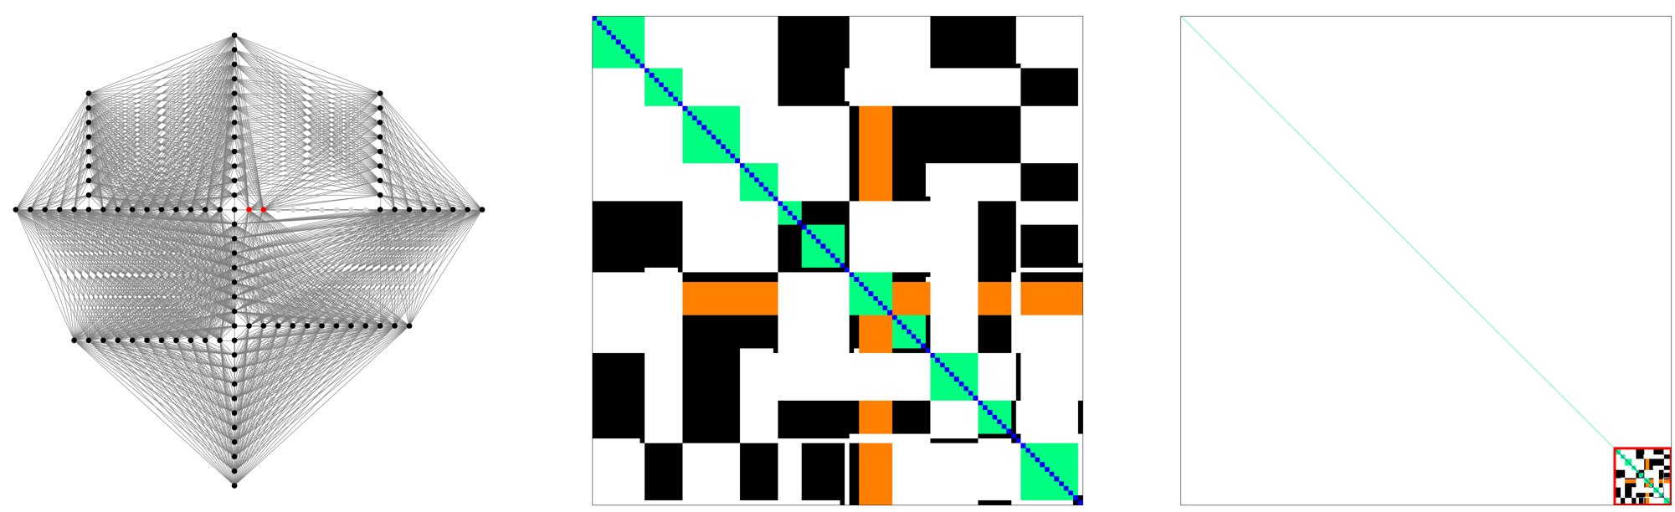
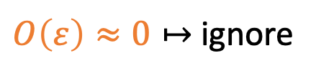
Sparsification: low-rank approximation
Identity
$O\left(ε\right)≈0↦$ ignore

Slide 19
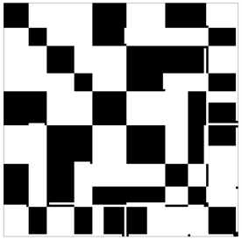
Defining interfaces through overlapping separators

Slide 20
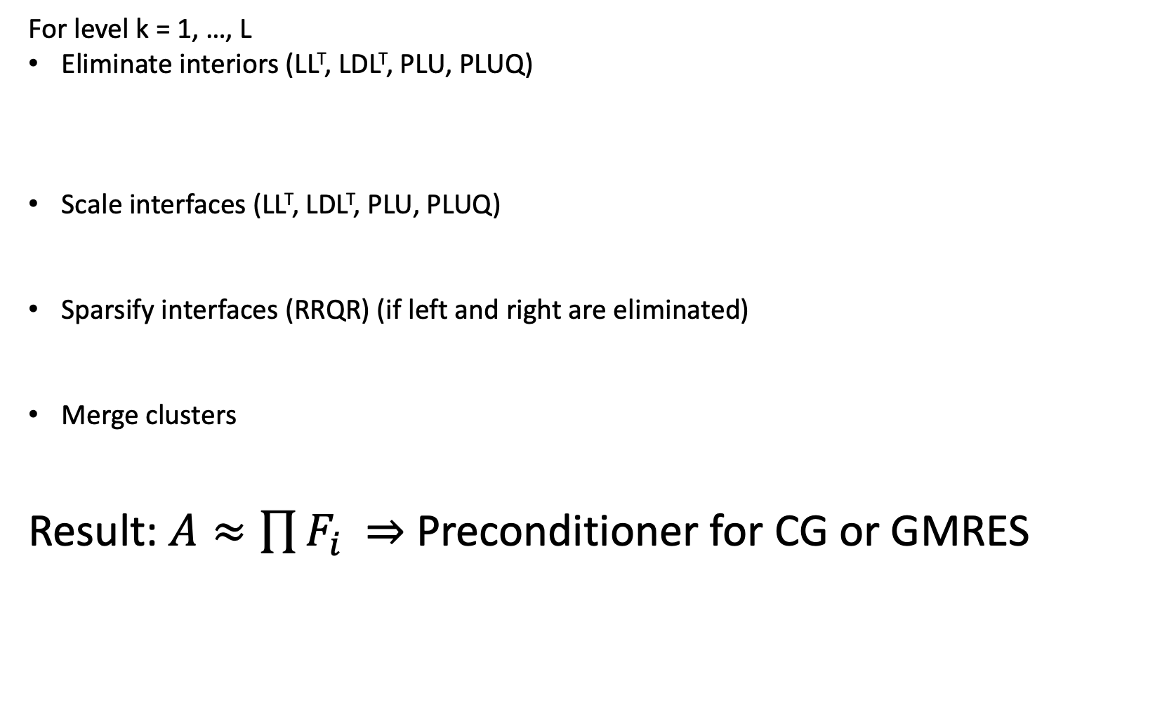
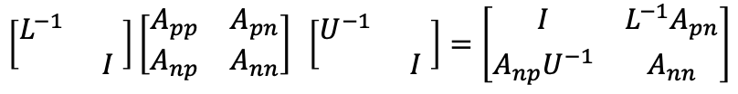
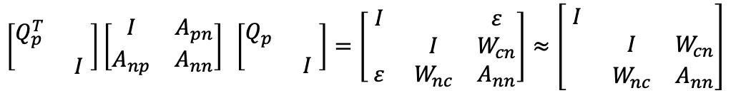
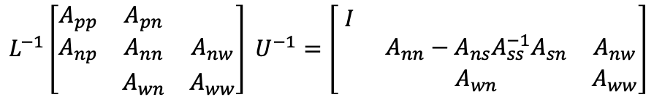
Eliminate ↦ Scale ↦ Sparsify ↺
Fill-in;
limited by separators
For level k = 1, …, L
Eliminate interiors (LL^{T}, LDL^{T}, PLU, PLUQ)
Scale interfaces (LL^{T}, LDL^{T}, PLU, PLUQ)
Sparsify interfaces (RRQR) (if left and right are eliminated)
Merge clusters
Result: $A≈\prod{F_{i}}$ ⇒ Preconditioner for CG or GMRES
$$L^{−1}\left[\begin{matrix}A_{pp} & A_{pn} & \\ A_{np} & A_{nn} & A_{nw} \\ & A_{wn} & A_{ww}\end{matrix}\right] U^{−1}=\left[\begin{matrix}I & & \\ & A_{nn}−A_{ns}A_{ss}^{−1}A_{sn} & A_{nw} \\ & A_{wn} & A_{ww}\end{matrix}\right]$$
No fill-in;
No approximations
$$\left[\begin{matrix}L^{−1} & \\ & I\end{matrix}\right]\left[\begin{matrix}A_{pp} & A_{pn} \\ A_{np} & A_{nn}\end{matrix}\right] \left[\begin{matrix}U^{−1} & \\ & I\end{matrix}\right]=\left[\begin{matrix}I & {L^{−1}A}_{pn} \\ A_{np}U^{−1} & A_{nn}\end{matrix}\right]$$
$$\left[\begin{matrix}Q_{p}^{T} & \\ & I\end{matrix}\right]\left[\begin{matrix}I & A_{pn} \\ A_{np} & A_{nn}\end{matrix}\right] \left[\begin{matrix}Q_{p} & \\ & I\end{matrix}\right]=\left[\begin{matrix}I & & ε \\ & I & W_{cn} \\ ε & W_{nc} & A_{nn}\end{matrix}\right]≈\left[\begin{matrix}I & & \\ & I & W_{cn} \\ & W_{nc} & A_{nn}\end{matrix}\right]$$
No fill-in!
Approximation
Sparse lower-triangular
and sparse orthogonal

Slide 21
spaND in action

Slide 22
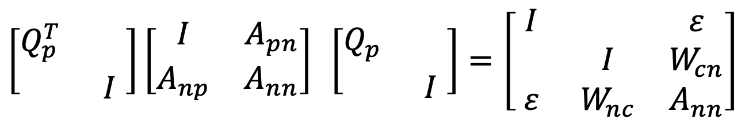
SPD remains SPD
SPD
If using Cholesky for elimination and scaling
$$\left[\begin{matrix}Q_{p}^{T} & \\ & I\end{matrix}\right]\left[\begin{matrix}I & A_{pn} \\ A_{np} & A_{nn}\end{matrix}\right] \left[\begin{matrix}Q_{p} & \\ & I\end{matrix}\right]=\left[\begin{matrix}I & & ε \\ & I & W_{cn} \\ ε & W_{nc} & A_{nn}\end{matrix}\right]$$
SPD
SPD
(submatrix of SPD)

Slide 23
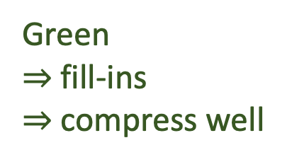
Separator sizes?
Eliminate
interiors
Interface (Brown + Green)
Brown
= “original” connections
= do not compress well
Green
⇒ fill-ins
$⇒$ compress well

Slide 24
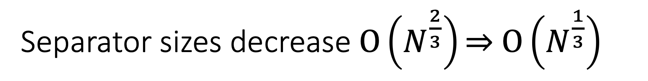
Separator sizes decrease $O\left(N^{\frac{2}{3}}\right)\text{⇒} O\left(N^{\frac{1}{3}}\right)$
“planes”
“lines”
Brown
⇒ what is left
after sparsification

Slide 25
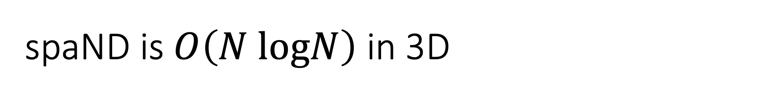
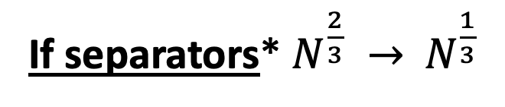
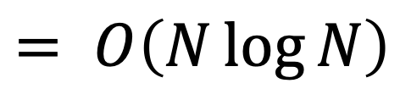


spaND is $O\left(N logN\right)$ in 3D
If separators* $N^{\frac{2}{3}} →$ $N^{\frac{1}{3}}$
Time
$$O\left(N\right)$$
$$O\left(N\right)$$
$$= O\left(N\log{N}\right)$$
Leaves
Top separator
* and few other assumptions

Slide 26
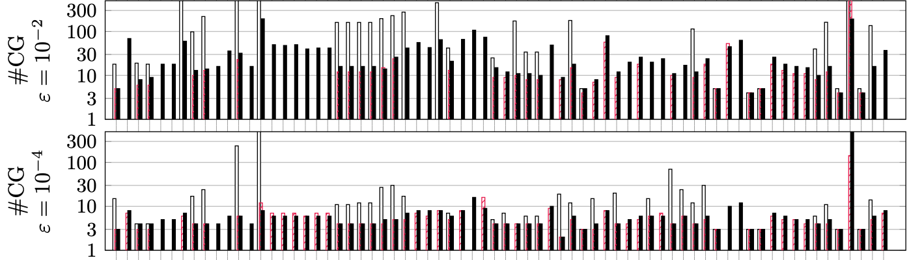
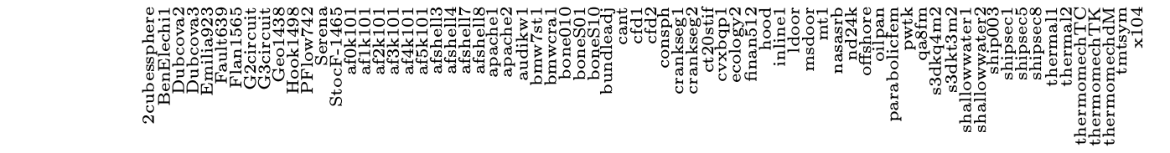
Orthogonal always works on SPD
Scaling improves accuracy
Black = spaND (Orthogonal, scaling)
Red = HIF* (Triangular, scaling)
White = HIF* (Triangular, no scaling)
All >50k SPD problems from SuiteSparse, except 2 that didn’t converge in <500
* Ho, K. L., & Ying, L. (2016). Hierarchical interpolative factorization for elliptic operators: differential equations. Communications on Pure and Applied Mathematics, 69(8), 1415-1451.

Slide 27





Ice-Sheet modeling
$$κ\left(A\right)>{10}^{11}$$
 |  | spaND |  |  |  | Direct | ILU(0) (Trilinos)
 | N | t_{Fact} (s.) | t_{CG} (s.) | n_{CG} | size_{Top} | t_{Fact}+t_{Solve} (s.) | t_{Solve} (s.)
5 layers | 0.6M (16km) | 7 | 3 | 7 | 78 | 19 | 23
 | 2.5M (8km) | 28 | 14 | 8 | 88 | 126 | 286
 | 10M (4km) | 124 | 89 | 10 | 99 | 1036 | 7137
10 layers | 1M (16km) | 23 | 7 | 7 | 137 | 86 | 42
 | 4.6M (8km) | 97 | 34 | 8 | 147 | 725 | 544
 | 18.5M (4km) | 538 | 311 | 10 | 159 | - | 18680
t_{Fact}+t_{CG} (sec.)
mem_{Fact} (Gnnz)
Problem from: Tezaur, Irina K., et al. "Albany/FELIX: a parallel, scalable and robust,
finite element, first-order Stokes approximation ice sheet solver built for advanced
analysis." Geoscientific Model Development (Online) 8.4 (2015).
Picture: Tezaur, Irina K., et al. "On the scalability of the Albany/FELIX first-order Stokes
approximation ice sheet solver for large-scale simulations of the Greenland and
Antarctic ice sheets." Procedia Computer Science 51 (2015): 2026-2035.
Thanks to E. Boman, R. Tuminaro, S. Rajamanickam & M. Perego

Slide 28


The SPE problem
 | spaND |  |  |  | Direct
N | t_{Fact} (s.) | t_{CG} (s.) | n_{CG} | size_{Top} | t_{Fact}+t_{Solve} (s.)
2M | 55 | 18 | 13 | 504 | 743
4M | 118 | 44 | 14 | 635 | 3677
8M | 254 | 102 | 16 | 962 | -
16M | 650 | 256 | 14 | 891 | -
Top separator
32 GB → 6MB
size_{Top}
mem_{Fact} (nnz)
Problem and picture from: Christie, Michael Andrew, and M. J. Blunt.
"Tenth SPE comparative solution project: A comparison of upscaling techniques." SPE reservoir simulation symposium. Society of Petroleum Engineers, 2001. Thanks to Bazyli Klockiewicz for the matrix

Slide 29




spaND also works on unsymmetric problems
3D advection-diffusion
Top separator size
GMRES steps
Factorization time
GMRES time
Matrix size
Matrix size
$−∇∙\left(a(x)∇u(x)\right)+b(x)∙∇u(x)=f(x)$, centered FD on ${\left[0,1\right]}^{3}$, $a={10}^{−2},b_{i}=1$

Slide 30
Conclusion
spaND is
Much faster than direct methods
Never breaks on SPD problems
Robust and versatile

Slide 31
TaskTorrent
Cambier, L., Qian, Y. and Darve, E. "TaskTorrent: a Lightweight Distributed Task-Based Runtime System in C++." To appear in Proceeding of the 2020 Parallel Application Workshop: Alternatives to MPI+X. arXiv preprint arXiv:2009.10697 (2020).

Slide 32
Runtime systems
Computations = tasks with dependencies
Runtime systems schedule tasks and
  avoid synchronization
  exploit all resources
POTRF(0)
TRSM(3,0)
TRSM(1,0)
TRSM(2,0)
for (k=0; k<n; k++) {
POTRF(A[k,k]);
for(i=k+1; i<n; i++) {
TRSM(A[k,k],A[i,k]);
}
for (i=k+1; i<n; i++) {
SYRK(A[i,k], A[i,i]);
for (j=k+1; j<i; j++) {
GEMM(A[i,k], A[j,k], A[i,j]);
}
}
}
GEMM(1,0,3)
SYRK(1,0)
GEMM(2,0,3)
GEMM(1,0,2)
SYRK(3,0)
TRSM(3,1)
POTRF(1)
TRSM(2,1)
SYRK(2,0)
GEMM(2,1,3)
SYRK(2,1)
SYRK(3,1)
POTRF(2)
TRSM(3,2)
SYRK(3,2)
POTRF(3)
Figure by Yizhou Qian

Slide 33
Two approaches: STF and PTG
Sequential task flow (STF)
Parametrized task graph (PTG)
/** Define tasks **/
void task(A: in, B: out)
/** Register data **/
A = [ ... ]
B = [ ... ]
/** Process DAG **/
for (i ..., j ...)
task(A[i], B[j])
/** Define DAG using
* functions of K
**/
in_deps = (K k) { ... }
task = (K k) { ... }
out_deps = (K k) { ... }
/** Seed tasks **/
for (k in kinit)
start(k)
Data dependencies inferred through data sharing rules
Task defined as functions over K
Computation triggered by seeding initial tasks

Slide 34

Existing solutions
for k = 0, n do
dpotrf(k, n, pA[f2d{i = k, j = k}])
for i = k+1, n do
dtrsm(i, k, n, pA[f2d{i = i, j = k}])
end
for i = k+1, n do
dsyrk(i, k, n, pA[f2d{i = i, j = i}],
pA[f2d{i = i, j = k}])
for (j=k+1; j<i; j++) {
dgemm(i, j, k, n,
pA[f2d{i = i, j = k}]),
pA[f2d{i = i, j = k}]),
pA[f2d{i = i, j = k}]))
end
end
end
Legion/Regent:
Sequential semantic (STF)
Custom language
May need tuning for good performances
Hard to use within legacy codes
PaRSEC:
Custom language (JDF)
Cannot use other data structures

Slide 35
Goals of TaskTorrent
Current adoption of runtime systems is low
Wider adoption requires
Easy to learn API
  No new language
  API with predictable behaviors
  Good OOTB performances
Good interaction with existing codebases
  Plays well with MPI and message-passing codes
  Incremental adoption
  Standard tools (MPI and C++)
  Any user data structures
  Minimal overhead, no task refactoring

Slide 36


STF is easier to use but may not scale
Need to enumerate the DAG !
POTRF
TRSM
GEMM
DAG of 4x4 Cholesky (tiny)
DAG of 20x20 Cholesky (very small)

Slide 37
TaskTorrent combines PTG and Active messages
Lightweight: PTG + AMs
Message-passing, with MPI and C++ threads
Any user data structures
Good performances out-of-the-box
Shared-memory
task-based runtime
Shared-memory
task-based runtime
One-sided
asynchronous
communications

Slide 38

How to use TaskTorrent?
/** Initialize structures **/
Communicator comm(MPI_COMM_WORLD);
Threadpool tp(n_threads, &comm);
Taskflow<int> tf(&tp);
/** Create active message **/
am = comm.make_active_msg(
[&](int d, int k, payload pk) {
data[k] = pk;
tf.fulfill_promise(d);
});
/** Define Taskflow **/
tf.set_mapping(mapping)
.set_indegree(n_deps)
.set_run([&](int k) {
compute(k);
for (auto d : deps(k)) {
int dest = task_2_rank(d);
if (dest == my_rank) {
tf.fulfill_promise(d);
} else {
am->send(dest, d, k, data[k]);
}
}
});
/** Start initial tasks **/
for (auto k : initial_tasks)
tf.fulfill_promise(k);
/** Wait for completion **/
tp.join();
Tasks are functions(K k)
  Mapping task to threads
  # incoming deps
  Computations + fulfill deps
Communications using AMs
  Send data + fulfill deps
Seed + join

Slide 39




Detecting completion is non-trivial
Asynchronous tasks
One sided communications
$$t_{0}$$
Rank 0
IDLE
$$t_{1}$$
Rank 1
IDLE
$$t_{2}$$
Rank 2
IDLE
$$t_{3}$$
Rank 3
IDLE

Slide 40

So what is “completion”?
$$t_{0}$$
Rank 0
IDLE
$$t_{1}$$
Rank 1
IDLE
$$t_{2}$$
Rank 2
IDLE
$$t_{3}$$
Rank 3
IDLE
Ranks are idle (no user tasks) at ${\left\{t_{r}\right\}}_{r}$
All messages sent before ${\left\{t_{r}\right\}}_{r}$ are received before ${\left\{t_{r}\right\}}_{r}$

Slide 41











Detecting completion is done in two stages
If $\sum_{r}{s_{r}=\sum_{r}{r_{r}}}$
If all YES
$$t_{0}^{−}$$
$$\overline{t}$$
$$t_{0}^{+}$$
$$\hat{t}$$
Rank 0
IDLE
$$t_{1}^{−}$$
$$t_{1}^{+}$$
Rank 1
IDLE
$$t_{2}^{−}$$
$$t_{2}^{+}$$
Rank 2
IDLE
$$t_{3}^{−}$$
$$t_{3}^{+}$$
Rank 3
IDLE
When change...
COUNT=(s_{r},r_{r})
STILL
SAME
COUNTS?
YES/NO
SHUTDOWN

Slide 42
No AM can cross the “envelope” ⇒ Idle forever
$$t_{0}^{−}$$
$$\overline{t}$$
$$t_{0}^{+}$$
$$\hat{t}$$
Rank 0
IDLE
$$t_{1}^{−}$$
$$t_{1}^{+}$$
Rank 1
IDLE
$$t_{2}^{−}$$
$$t_{2}^{+}$$
Rank 2
IDLE
$$t_{3}^{−}$$
$$t_{3}^{+}$$
Rank 3
IDLE

Slide 43
Properties of the completion algorithm
Theorem 1:
If the user creates a finite number of messages, the algorithm uses a finite number of messages
⇒ Finishes even if MPI is unfair
Theorem 2:
The algorithm terminates if and only if completion is reached
⇒ Correct

Slide 44
Benchmarks
We compare
TaskTorrent
StarPU (STF)
Intel ScaLAPACK (MPI + OpenMP)
We show that
Runtimes outperform bulk-synchronous (ScaLAPACK)
TTOR (PTG) is competitive with other SOTA runtimes (StarPU, STF)
TTOR is easy to use
PTG scales better than STF when tasks are small

Slide 45








Distributed GEMM
Strong and weak scalings
Time [sec.]
Time [sec.]
A
B
C
Cores
Cores
0 | 1 | 0 | 1
2 | 3 | 2 | 3
0 | 1 | 0 | 1
2 | 3 | 2 | 3
0 | 1 | 0 | 1
2 | 3 | 2 | 3
0 | 1 | 0 | 1
2 | 3 | 2 | 3
0 | 1 | 0 | 1
2 | 3 | 2 | 3
0 | 1 | 0 | 1
2 | 3 | 2 | 3
TaskTorrent 2D
TaskTorrent 3D
=
Time [sec.]
Time [sec.]
Block ↦ node mapping
$$C_{ij}=\sum_{k}{A_{ik}B_{kj}}$$
Cores
Cores
StarPU 2D
ScaLAPACK 2D
gemm_Cikj.set_task([&](int3 ikj){
int i = ikj[0];
int k = ikj[1];
int j = ikj[2];
C_ij[i + j * num_blocks].noalias() +=
A_ij[i + k * num_blocks] *
B_ij[k + j * num_blocks];
if(k < num_blocks-1) {
gemm_Cikj.fulfill_promise({i,k+1,j});
}
}).set_indegree([&](int3 ikj) {
return (ikj[1] == 0 ? 2 : 3);
}).set_mapping([&](int3 ikj) {
return (ikj[0] / nprows + ikj[2] / npcols
* (num_blocks / nprows)) % n_threads;
});
Time [sec.]
Block size
Block size impact
(N=32k, 1024 CPUs)

Slide 46






Distributed dense Cholesky
Strong and weak scalings
A
L
L^{T}
0
2 | 3
0 | 1 | 0
2 | 3 | 2 | 3
0
2 | 3
0 | 1 | 0
2 | 3 | 2 | 3
0
2 | 3
0 | 1 | 0
2 | 3 | 2 | 3
Time [sec.]
Time [sec.]
=
Block ↦ node mapping
Cores
Cores
TaskTorrent
StarPU
Time [sec.]
Time [sec.]
Time [sec.]
max block size / average block size
Load balancing test
Various average block sizes
N=65k, 1024 CPUs
Cores
Block size
ScaLAPACK
Block size impact
(N=65k, 1024 CPUs)

Slide 47
Conclusion
TTOR combines PTG + AMs
Its design makes it
  Lightweight, minimal overhead, parallel DAG exploration
  Easy to use and integrate into an existing code
  Good out-of-the-box performances
https://github.com/leopoldcambier/tasktorrent

Slide 48
Task-based distributed spaND
With TaskTorrent

Slide 49





spaND sparsification is usually sequential
For level k = 1, …, L
Eliminate interiors
Scale interfaces
Sparsify interfaces
  Compute $Q_{p}$ (depends on $A_{pn},A_{np}$ for all $n)$
  Update $A_{nc}←A_{np}Q_{pc}, { A}_{pc}←Q_{pc}^{T}A_{pn}$
Dependency!
$$Q_{i}^{}$$
$$Q_{j}^{}$$
$$Q_{i}^{T}$$
$$Q_{j}^{T}$$

Slide 50











Simultaneous sparsification is more concurrent...
For level k = 1, …, L
Eliminate interiors
Scale interfaces
Sparsify interfaces
  For all $p$, compute $Q_{p}$ (w/ original $A_{pn},A_{np}$)
  Update $A_{ij}^{+}={Q_{ic}^{T}A}_{ij}Q_{jc}$
More concurrent
More flops
Less accurate ?
$$Q_{1}$$
$$Q_{2}$$
$$Q_{3}$$
$$Q_{4}$$
$$Q_{5}$$
$$Q_{1}^{T}$$
$$Q_{2}^{T}$$
$$Q_{3}^{T}$$
$$Q_{4}^{T}$$
$$Q_{5}^{T}$$

Slide 51



























... and as accurate
$$Q_{i}^{T}$$
Sequential sparsification
Simultaneous sparsification
$$Q_{j}$$
$$A_{ij}$$
$$W_{ij}^{1}$$
$$ε$$
$$A_{ij}$$
$$W_{ij}^{1}$$
$$ε$$
$$Q_{i}^{T}$$
$$=$$
$$Q_{i}^{T}$$
$$=$$
$$A_{ij}$$
$$W_{ij}^{2}$$ | $$ε$$
$$W_{ij}^{1}$$
$$Q_{j}^{}$$
$$=$$
$$W_{ij}^{2}$$ | $$ε$$
$$Q_{j}^{}$$
$$=$$
$$A_{ij}$$
$$W_{ij}^{2}$$ | $$ε$$
$$ε$$ | $$ε$$
$$A_{ij}$$
$$A_{ij}^{+}$$ | $$ε$$
$$ε$$ | $$ε$$
$$Q_{i}^{T}$$
$$Q_{j}^{}$$
$$=$$
$$Q_{i}^{T}$$
$$Q_{j}^{}$$
$$=$$

Slide 52



How to express the DAG?
1 block operation ⇔ 1 task
Granularity = interfaces
Level-per-level DAGs
Rank revealing QR...
Inputs: scaled ($A_{pn}$, $A_{np}$) from block scaling
Task: RRQR, $Q_{p}=RRQR\left(\left[\begin{matrix}A_{pn} & A_{np}^{T}\end{matrix}\right]\right)$
Output: sends $Q_{p}$, triggers compressions $Q_{p}^{T}A_{pq}Q_{q}$ and $Q_{q}^{T}A_{qp}Q_{p}$
Scaled
$$A_{pn}$$
$$Q_{p}$$

Slide 53

Per-level DAG is wide
Elimination
Block Scaling
Sparsification

Slide 54



Still some limitations in 3D
Since Tasks ⇔ Block operation between interfaces
In 3D
In 2D
$$≈O\left(N\right)$$
$$≈O\left(N\right)$$
$$≈O(1)$$
Time
Time
Leaves
Many tasks
Top separator
Few tasks
Leaves
Many tasks
Top separator
Few tasks

Slide 55



Ice-Sheet
Ranks are (fairly) uniform throughout the domain
Horizontal
resolution
Maximum ranks
Ranks
Average ranks
Level from top
Minimum = 22, Average = 98, Maximum = 350

Slide 56

Ice-Sheet: good weak scalings
cores | N | spaND |  |  |  | AMG (Hypre)
 |  | t_{fact} | t_{app} | n_{CG} | t_{total} | n_{CG} | t_{total}
36 | 1M | 6.2 | 0.14 | 6 | 7.1 | 427 | 15
144 | 4M | 7.3 | 0.15 | 6 | 8.5 | 456 | 16
576 | 18M | 8.9 | 0.15 | 7 | 10.5 | 527 | 22
2304 | 74M | 9.8 | 0.17 | 8 | 11.7 | 627 | 29
9216 | 296M | 13.2 | 0.21 | 12 | 16.9 | 623 | 39
Weak scalings. 36 cores (N=1M) to 9216 cores (N=296M).
$ε={10}^{−2}$. CG stops at ${10}^{−8}$. Hypre using Boomer AMG. On Quartz (LLNL)

Slide 57

TTOR DAG
Eliminations
Block scalings
Sparsification

Slide 58


spaND in SU2: the NACA airfoil
Inviscid flow around a wing
Euler equations
Flow
Wing
Density
SU2: Economon, T. D., Palacios, F., Copeland, S. R., Lukaczyk, T. W., & Alonso, J. J. (2016).
SU2: An open-source suite for multiphysics simulation and design. AIAA Journal, 54(3), 828-846.
Thanks to Zan Xu and Juan Alonso
Ranks from 40 to 296
Strong directionality in the ranks

Slide 59



Some difficulties with irregular ranks
Matrix size (cores)
250k (8)
1M (32)
4M (128)
16M (512)
Factorization time
GMRES steps
67M (2048)
Newton step
Newton step
Weak scalings. 8 cores (N = 250k) to 2048 cores (N = 67M).
$ε={10}^{−3}$. GMRES stops at ${10}^{−3}$. Newton stops at ${10}^{−14}$. On Armstrong (Stanford HPCC)

Slide 60
Conclusion and perspectives

Slide 61

Hierarchical solvers are versatile
spaND
Can be used on many matrices
For most problems, complexity is about $O(N\log{N)}$
Guaranteed to work on SPD
More studies on unsymmetric problems are needed
Full, general 3D task-based parallel require distributed RRQRs or other sparsification approach

Slide 62
Task-based runtimes have to be easy to use
Runtime systems need to be easy to use for adoption
A simple approach like TTOR scales well in practice
It is easy to combine with block algorithms such as spaND and leads to excellent performances

Slide 63
References
spaND
  HIF: Ho, Kenneth L., and Lexing Ying. "Hierarchical interpolative factorization for elliptic operators: differential equations." Communications on Pure and Applied Mathematics 69.8 (2016): 1415-1451.
  spaND: Cambier, Léopold, et al. "An algebraic sparsified nested dissection algorithm using low-rank approximations." SIAM Journal on Matrix Analysis and Applications 41.2 (2020): 715-746.
  2nd order spaND: Klockiewicz, Bazyli, et al. "Second Order Accurate Hierarchical Approximate Factorization of Sparse SPD Matrices." arXiv preprint arXiv:2007.00789 (2020).
  Suitesparse: Davis, Timothy A., and Yifan Hu. "The University of Florida sparse matrix collection." ACM Transactions on Mathematical Software (TOMS) 38.1 (2011): 1-25.
  Ice-sheet: Tezaur, Irina K., et al. "Albany/FELIX: a parallel, scalable and robust, finite element, first-order Stokes approximation ice sheet solver built for advanced analysis." Geoscientific Model Development (Online) 8.4 (2015).
  SPE: Christie, Michael Andrew, and M. J. Blunt. "Tenth SPE comparative solution project: A comparison of upscaling techniques." SPE reservoir simulation symposium. Society of Petroleum Engineers, 2001.
  SU2: Economon, Thomas D., et al. "SU2: An open-source suite for multiphysics simulation and design." Aiaa Journal 54.3 (2016): 828-846.
TaskTorrent & runtimes
  StarPU: Augonnet, Cédric, et al. "StarPU: a unified platform for task scheduling on heterogeneous multicore architectures." Concurrency and Computation: Practice and Experience 23.2 (2011): 187-198
  Legion: Bauer, Michael, et al. "Legion: Expressing locality and independence with logical regions." SC'12: Proceedings of the International Conference on High Performance Computing, Networking, Storage and Analysis. IEEE, 2012.
  Regent: Slaughter, Elliott, et al. "Regent: a high-productivity programming language for HPC with logical regions." Proceedings of the International Conference for High Performance Computing, Networking, Storage and Analysis. 2015.
  PaRSEC: Bosilca, George, et al. "Parsec: Exploiting heterogeneity to enhance scalability." Computing in Science & Engineering 15.6 (2013): 36-45.
  TaskTorrent: Cambier, Léopold, Yizhou Qian, and Eric Darve. "TaskTorrent: a Lightweight Distributed Task-Based Runtime System in C++." arXiv preprint arXiv:2009.10697 (2020).

Slide 64




Funding
Fellowship from Total S.A.
Research grants from
  DOE (E-NA0002373-1)
  Sandia National Lab (LDRD)
  NASA (80NSSC18M0152)

Slide 65
Thank you for attending!
Now is a great time to ask questions

